Slide 1
Detecting Lane Lines William Gillespie

Slide 2
Udacity Self Driving Car Nanodegree
Term 1 topics
Lane Line Detection
Traffic Sign Detection
Behavioral Cloning

Slide 3
Libraries Used
OpenCV
NumPy
matplotlib

Slide 4
Lane Line Detection Data Pipeline
Convert color image to greyscale
Apply Gaussian Smoothing to the image
Apply Canny Edge detection to image
Define a region of interest
Calculate the Hough lines.
Draw lines Hough lines on black canvas.
Fit lines using Hough lines on the image.

Slide 5
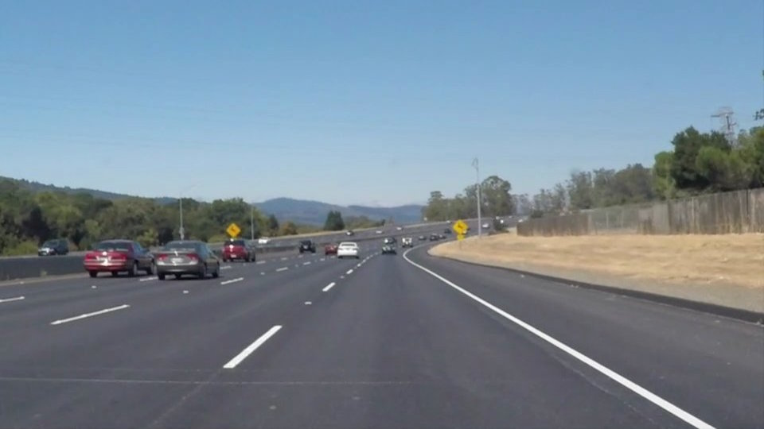
Convert the Image to Greyscale
Motivation
1 color channel vs. 3.
Only interested in white lane
Downside
Yellow lines harder to detect
Less information
greyscale_image = cv2.cvtColor(image, cv2.COLOR_BGR2GRAY)

Slide 6
Gaussian Smoothing
Makes the image blurry.
Averages a pixel value using surrounding pixels.
Used to reduce noise / ignore bogus gradients
Preprocessing step for Canny Edge Detection

Slide 7
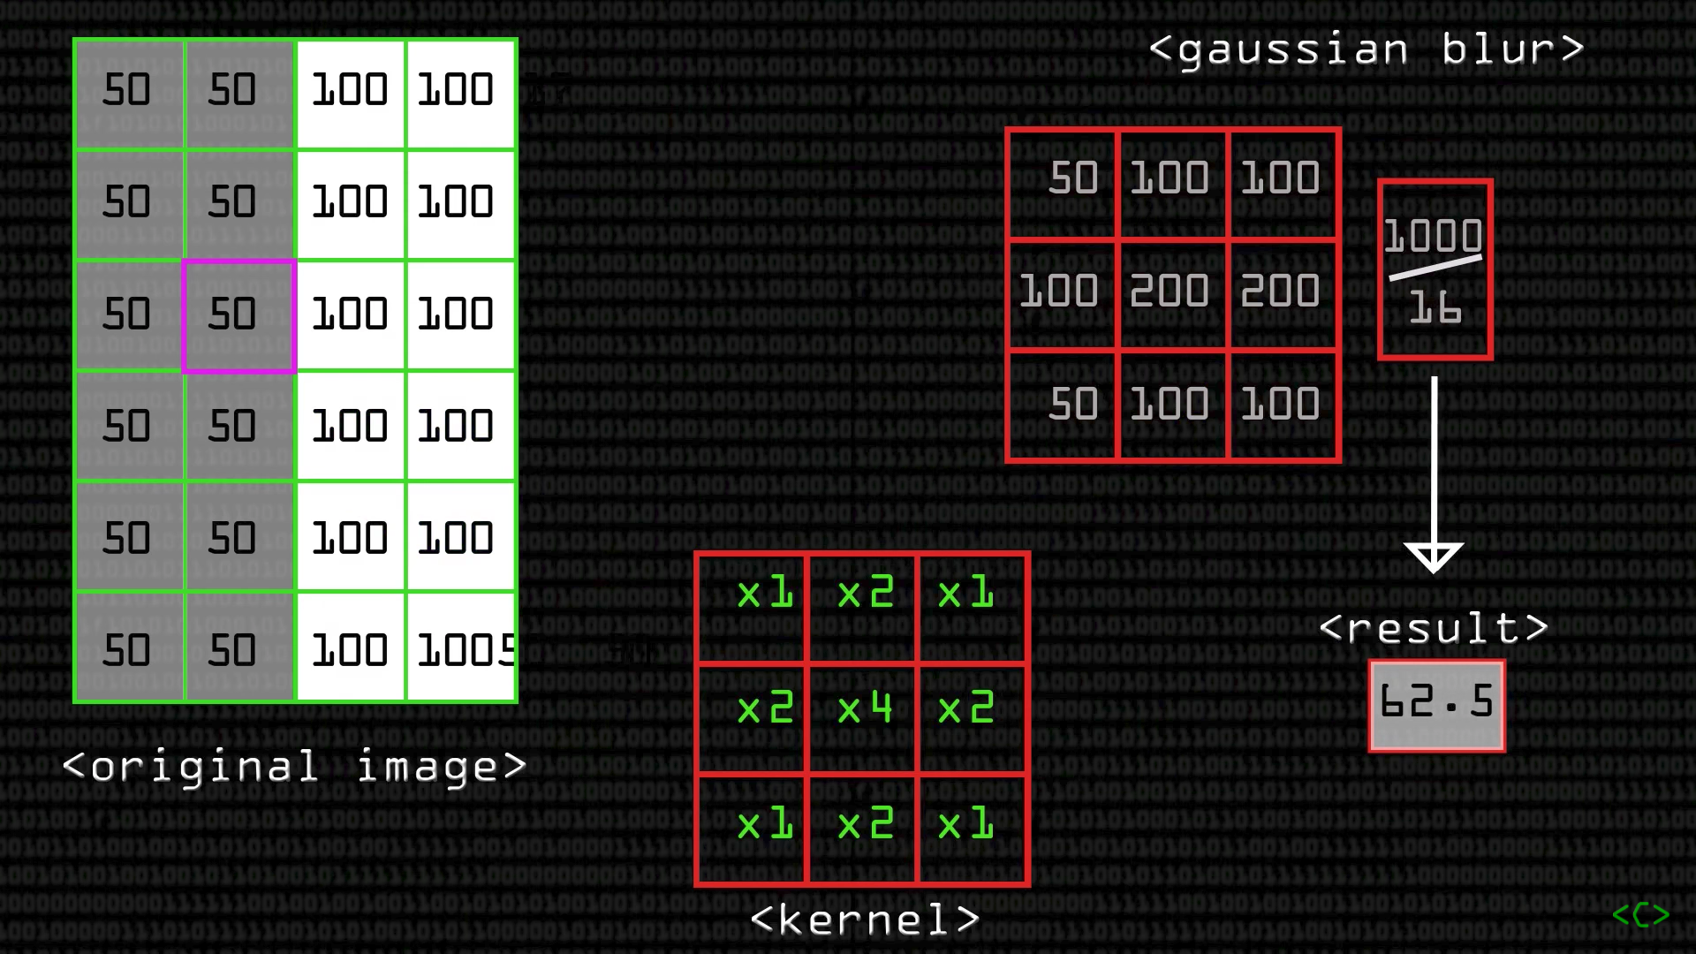

Slide 8
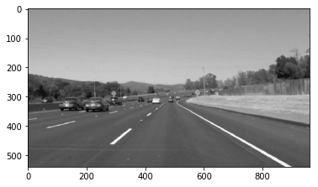
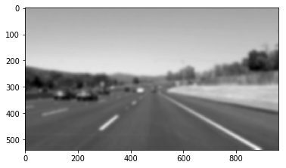
Gaussian Blur Images
5x5
Kernel
31x31
Kernel

Slide 9
Canny Edge Detection
Brief explanation
Calculate magnitudes of all dx and dy values of the pixels
Aggregate the differences for each pixel
Apply a minimum and maximum threshold to the differences
Pixels above the max threshold are classified as an edge pixel because they represent a high gradient
Pixels below the min threshold are discarded
Pixels in between are kept only if they are adjacent to pixels above threshold
I chose values similar to 50 and 150.
Further Learning: Sobel Operator.
https://www.youtube.com/watch?v=uihBwtPIBxM

Slide 10
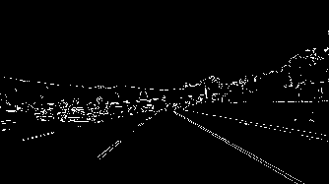
Canny Images
Canny without Gaussian Blur

Slide 11
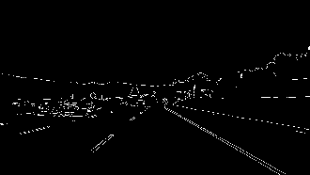
Canny Images
Canny with Gaussian Blur Preprocessing

Slide 12
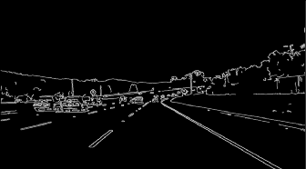
Canny Images
Canny with Gaussian Blur Post processing

Slide 13
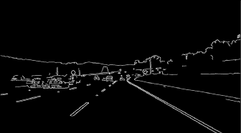
Canny Images
Canny with Gaussian Blur Pre & Post processing

Slide 14
Define a Region of Interest
Define a region for the lane lines.
Ignore edges outside of this region.
4 point polygon.
Cutting Edge measurement system

Slide 15
Hough Transform
Performed On a Canny Image
Somewhat difficult to understand
Link: https://homepages.inf.ed.ac.uk/rbf/HIPR2/hough.htm
Short Explanation…

Slide 16
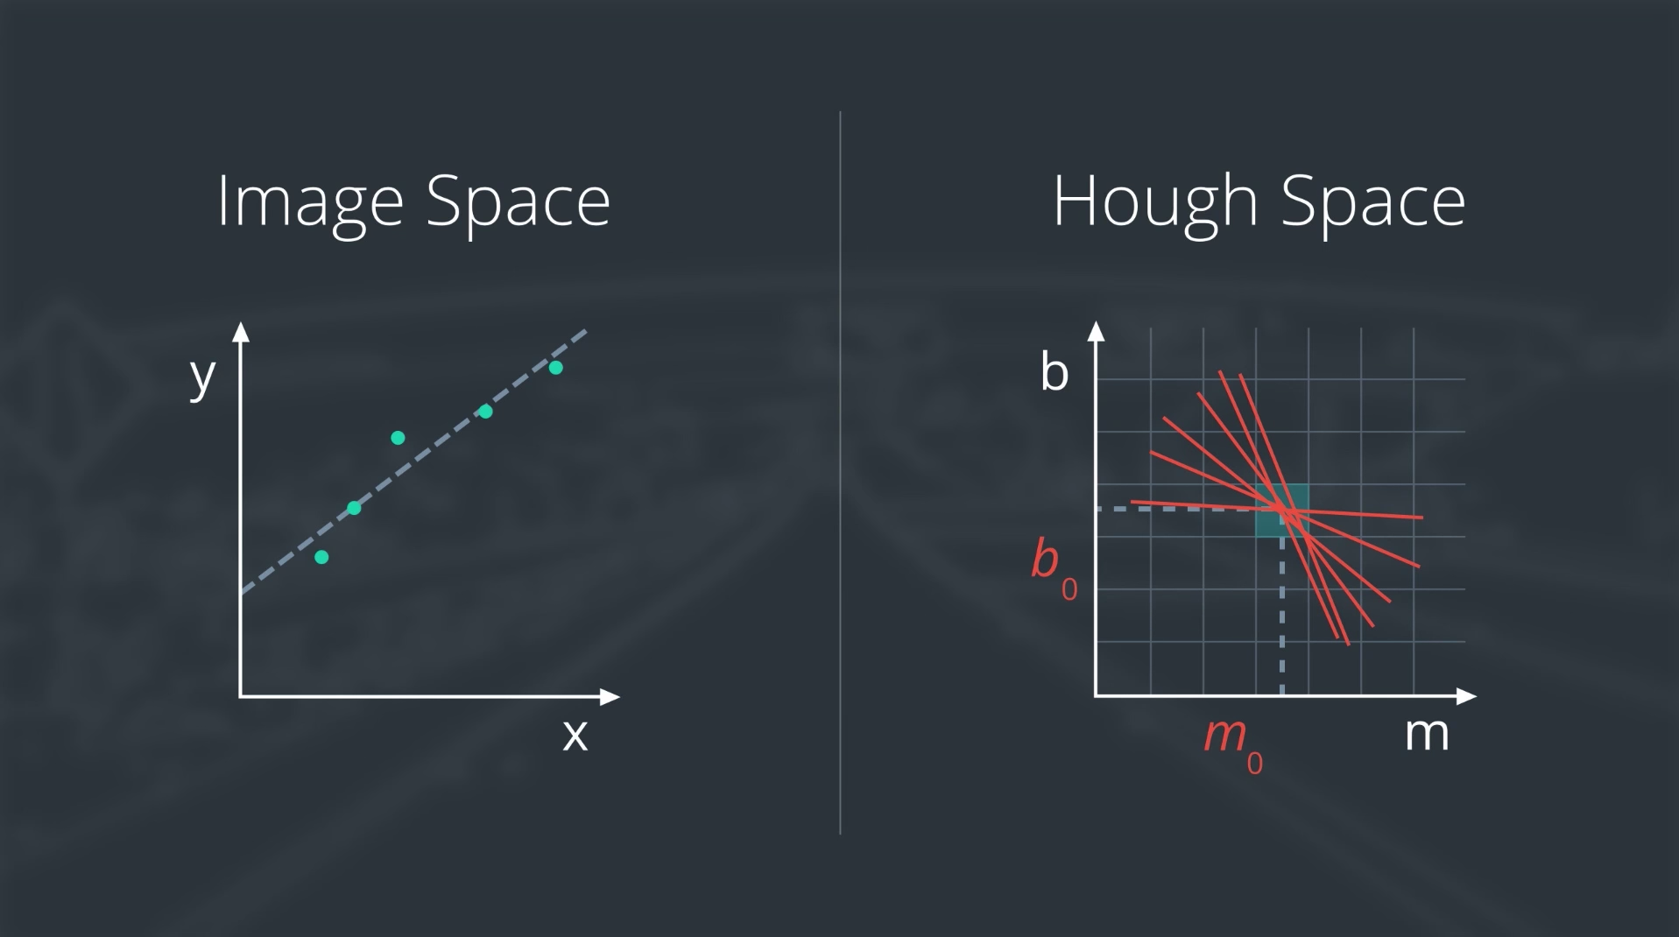

Slide 17
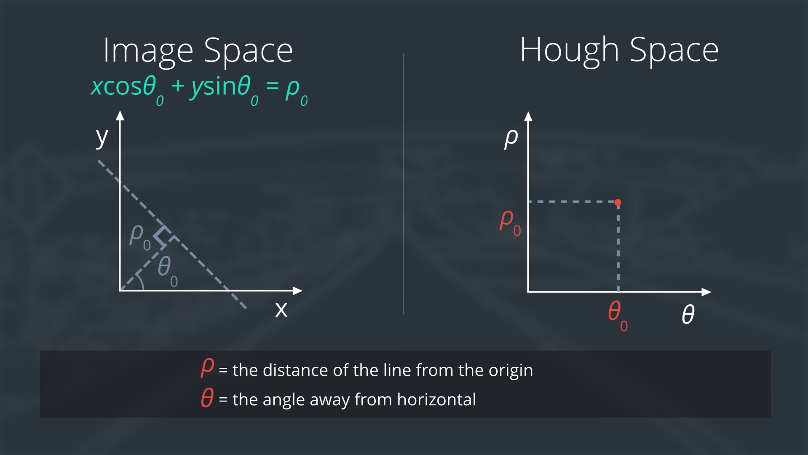

Slide 18
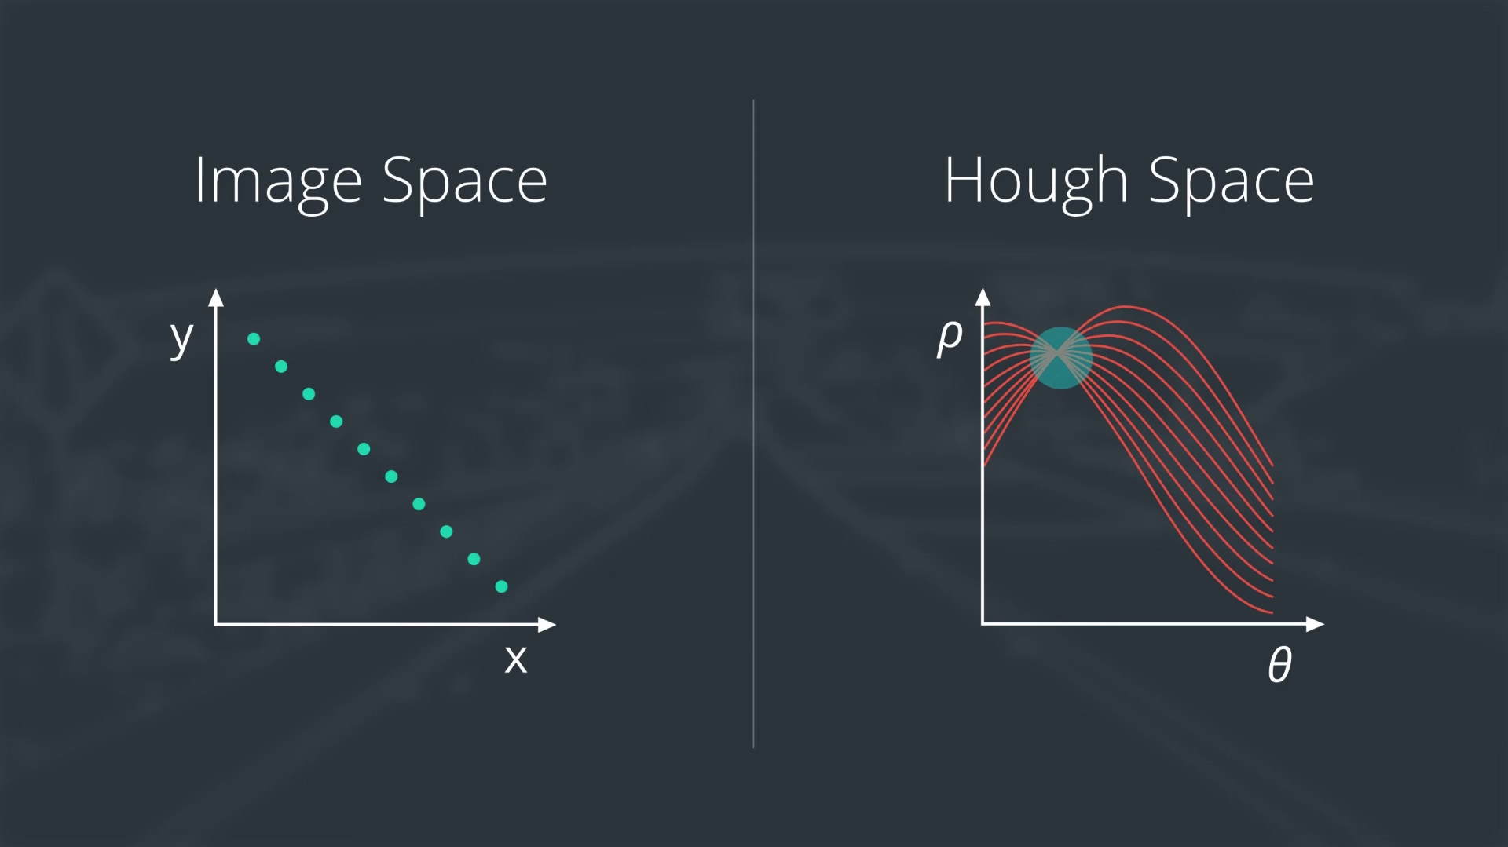

Slide 20
Hough Transform Image

Slide 21
Hough Lines: Distributions of Slopes

Slide 22
Hough Lines: Distributions of Distances

Slide 23
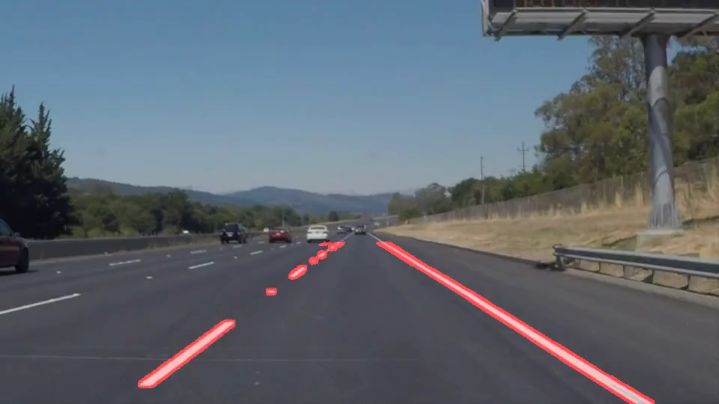
Hough Transform Video

Slide 24
Fitting Lines to Hough Lines
We want to fit lines to the lanes, but...
Hough Lines are problematic:
Many noisy lines.
Some lines do not represent lane lines.
This can negatively affect a the linear regression we perform.
Solution:
Filter lines that Have a slope outside a given range.
Filter lines that straddle the midpoint of the image
In one image, the number of Hough lines was reduced from around 300 to 8

Slide 25
Hough Line Filtering: before & after
Before
After

Slide 26
Fitting Lines to Hough Lines (continued)
For each line:
Determine what lane line it belongs to.
Place the x and y points for each lane into arrays.
left_xs = [ ]
left_ys = [ ]
right_xs = [ ]
right_ys = [ ]

Slide 27
Fitting Lines to Hough Lines: Linear Regression

Slide 29
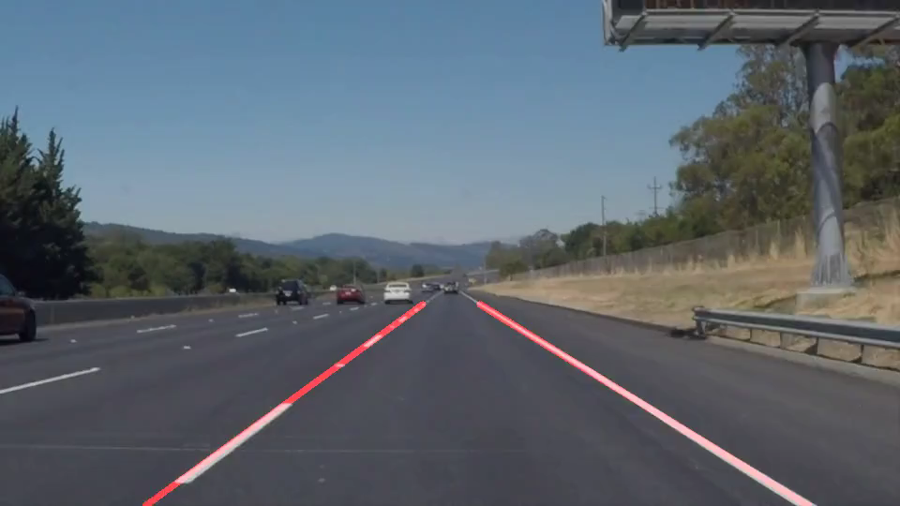
Video: With White Lane Lines

Slide 30
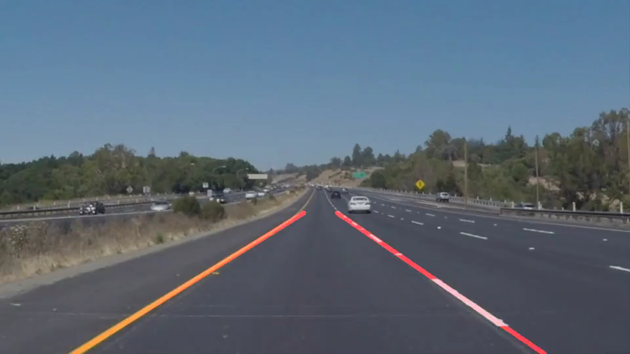
Video: With Yellow Lane Line

Slide 31
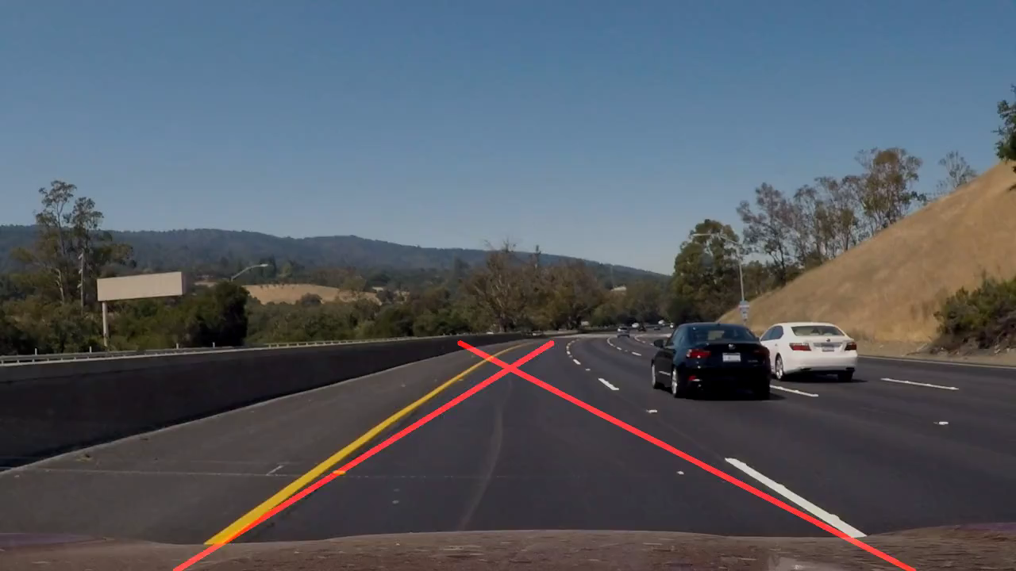
Video: Curvy Road

Slide 32
Improvements
Adjust the Region of Interest
If the slope is bogus, we can lower the region of interest’s top 2 points and recalculate the slope.
This may help the curvy road example
More Filtering of the Hough lines
Adjust the slope at which lines are rejected.
Prohibit Rapid Change of slope.
Keep track of slope for n frames.
If the slope deviates too much, we average the past few frames’ slope

Slide 33
Write up
https://github.com/Wubuntu88/CarND-LaneLines-P1/blob/master/writeup_William_Gillespie.md
Project Location
https://github.com/Wubuntu88/CarND-LaneLines-P1

Slide 34
Questions

